Slide 1

PROG6212
POE Presentation
ST10340607
Justin Anderssen

Slide 2
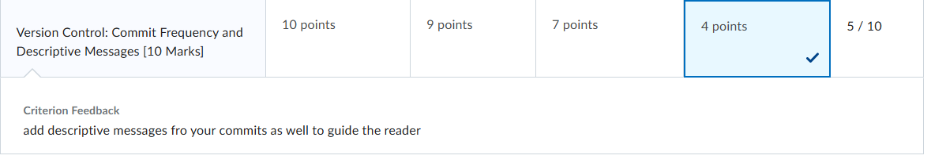
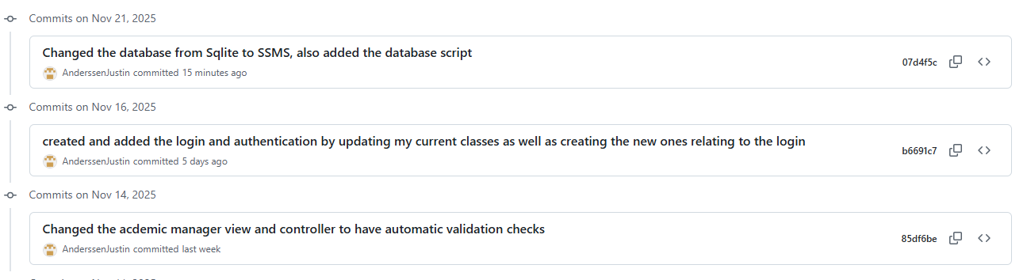
Lecturer Feedback
I Updated my part 3 by ensuring when I make commits that the messages were clear and descriptive. They also needed to guide the reader on what had changed.
The new part 3 commit messages shown below

Slide 3
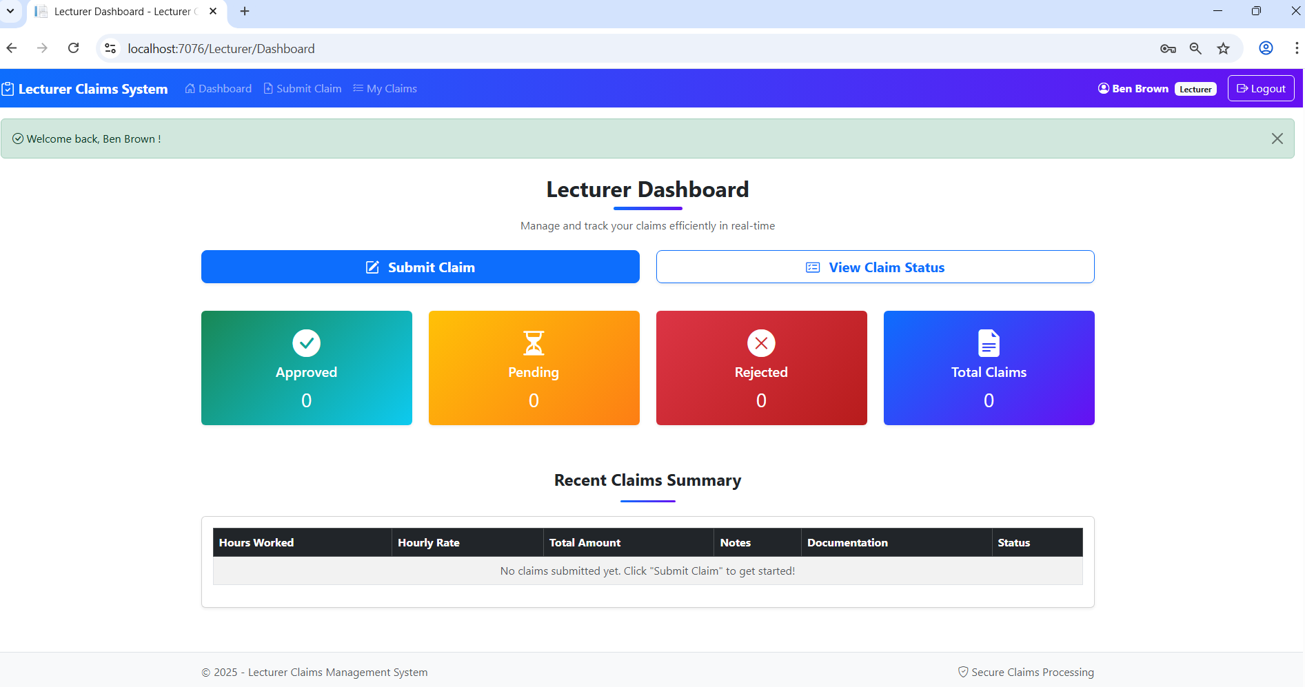
Lecturer Feedback
I Changed the look of the GUI to look more appealing and used different colours to attract the users attention and help guide the user better like for claims that are denied I used red and green for the approved ones

Slide 4
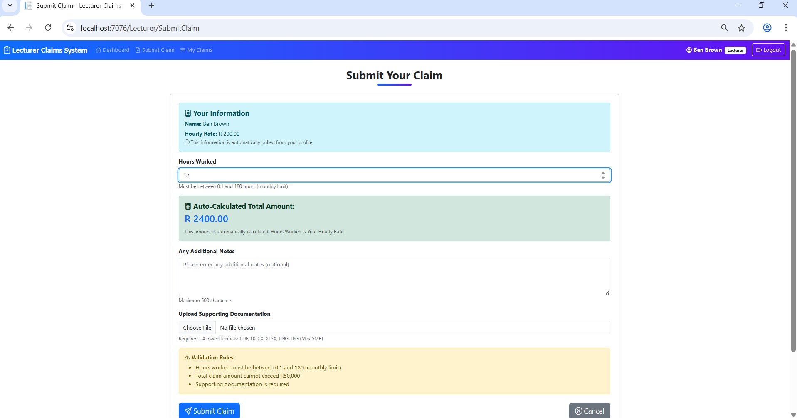
Submit Claim Page Part 3
This is where the lecturer submits their claim, the lecturer amount is auto calculated based on the lecturer that logs in, which is set by the hr.
There is also auto validation if the field aren’t fill in correctly

Slide 5
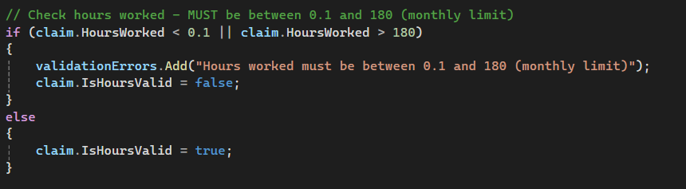
The code below show the auto calculation logic for the application
The code below shows one of the four validation checks, this one is checking if the hours a lecturer can works is above 0.1 and below 180

Slide 6
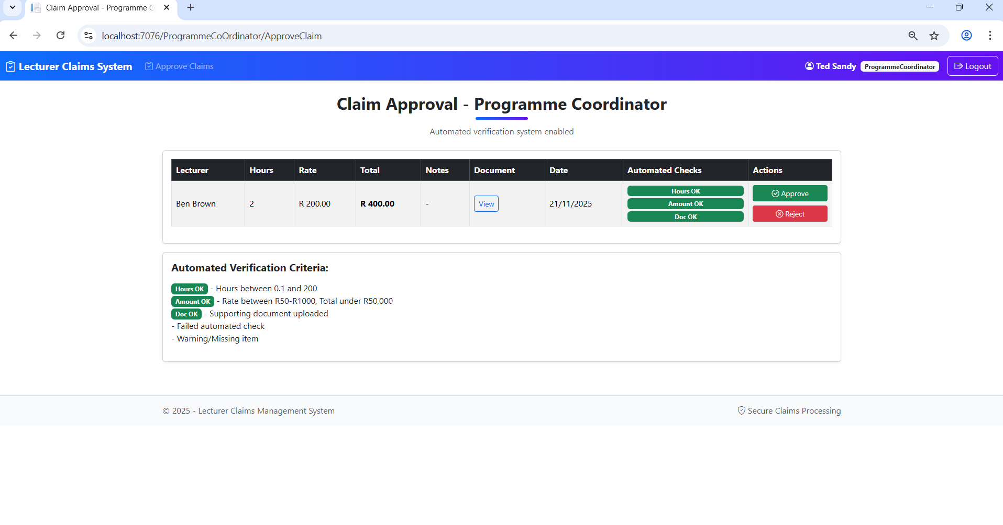
The programme Co-Ordinator now has automatic validation for all the different claims to ensure that all the required information is there. They can then approve or reject the claim

Slide 7
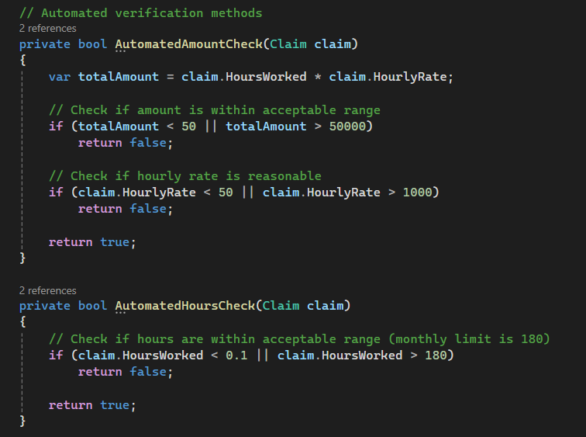
The code below shows the logic for the automated checks for the Programme Co Ordinator.
The code takes the value and compares it to pre-set values in order to determine if the information has been provided

Slide 8
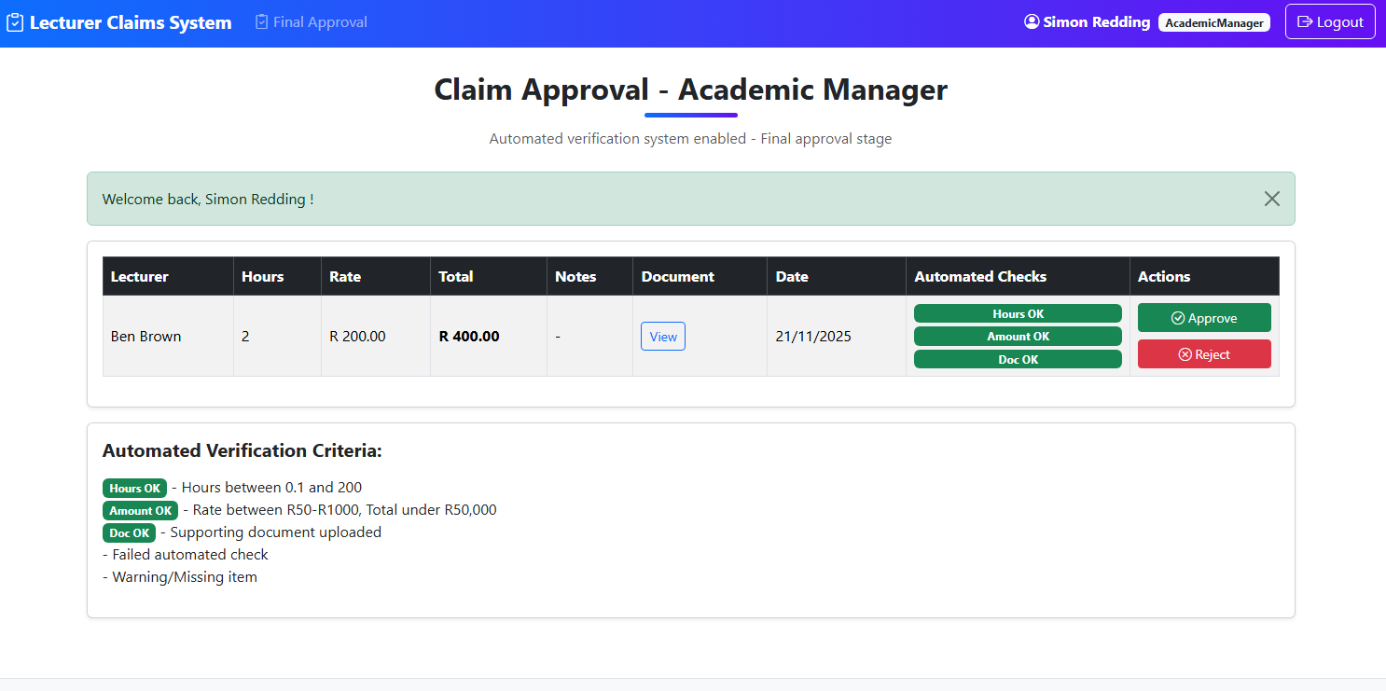
This is the validation checks for the Academic manager.
It works in the same way as it does for the programme manager

Slide 9
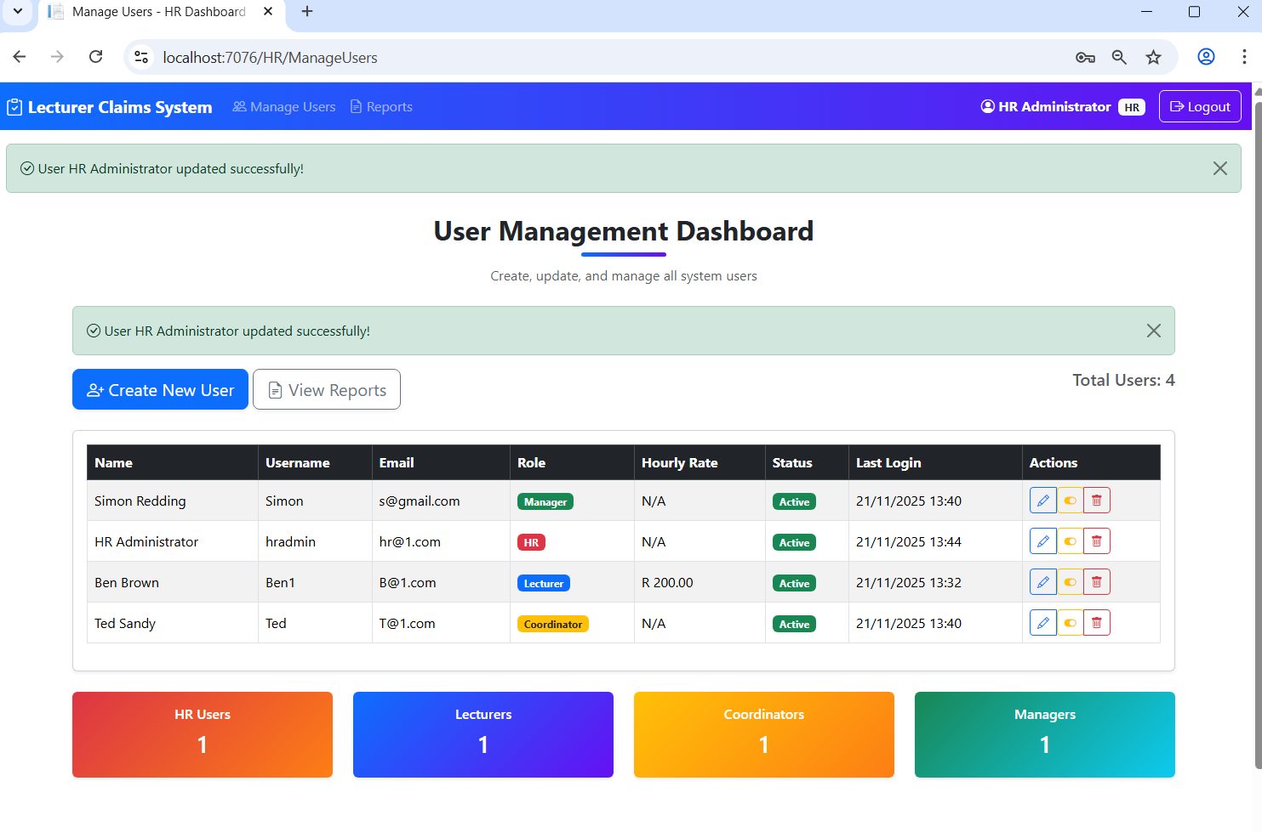
This is the HR dashboard from here they are able to create, delete and edit users and view reports

Slide 10
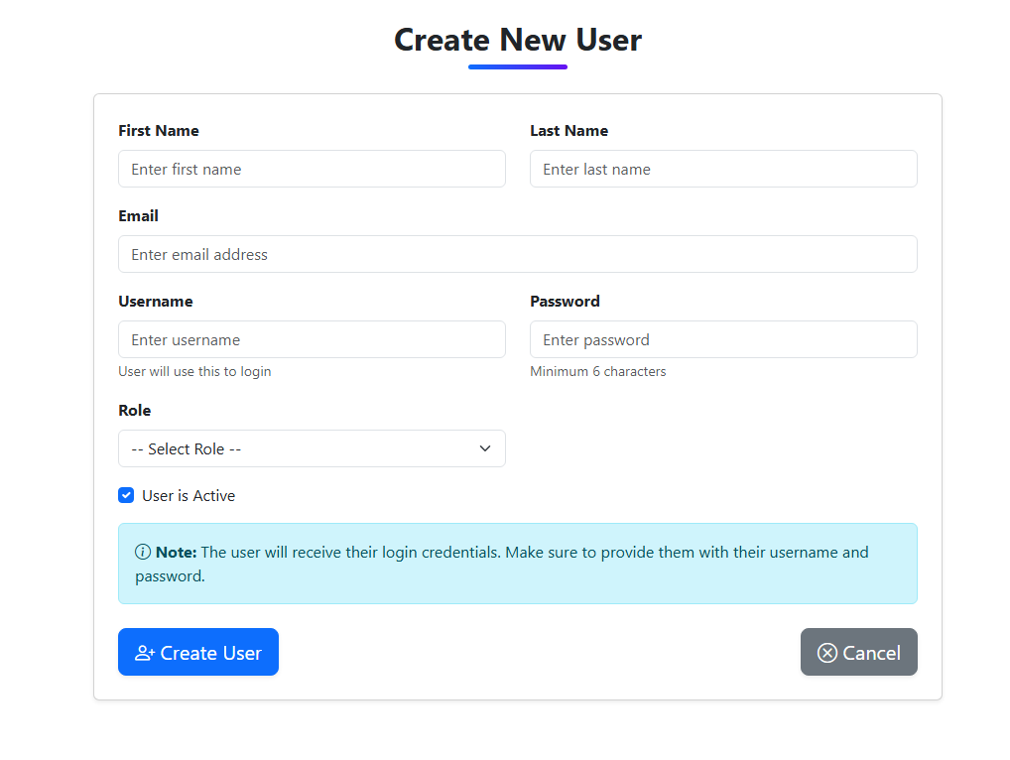
Form to create the User

Slide 11
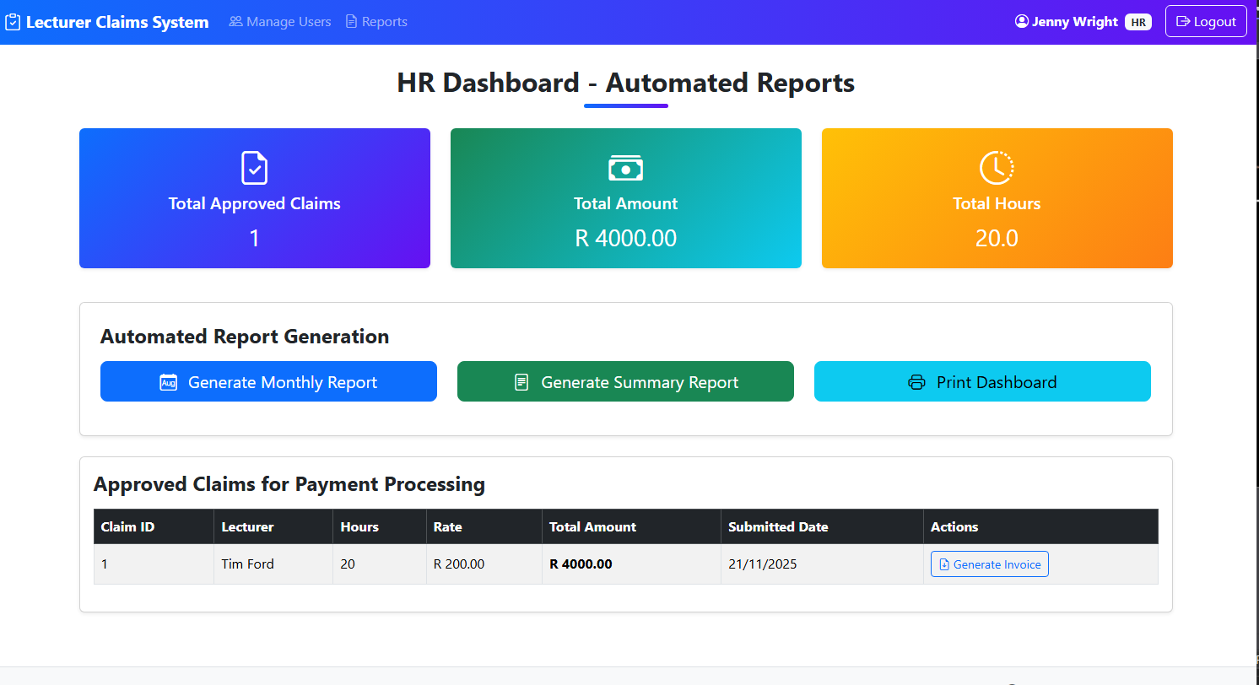
This is the home page to generate the different reports

Slide 12
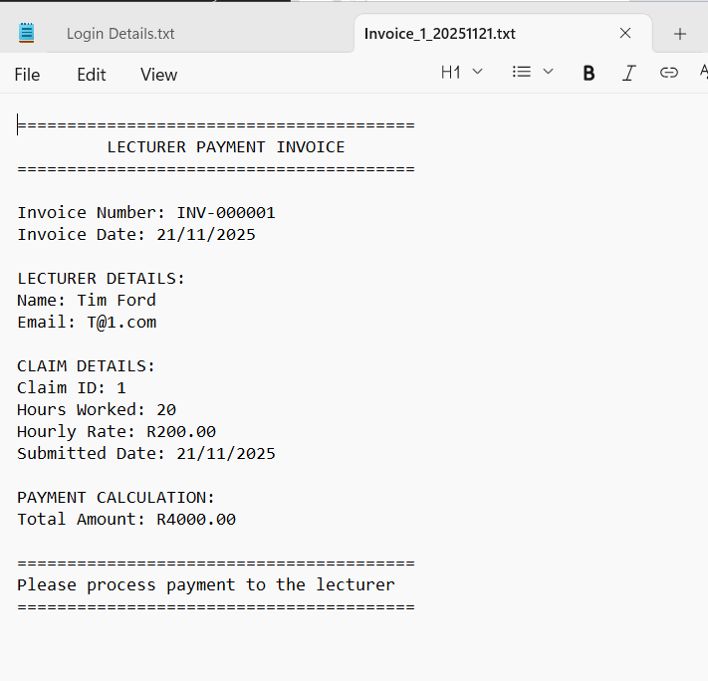
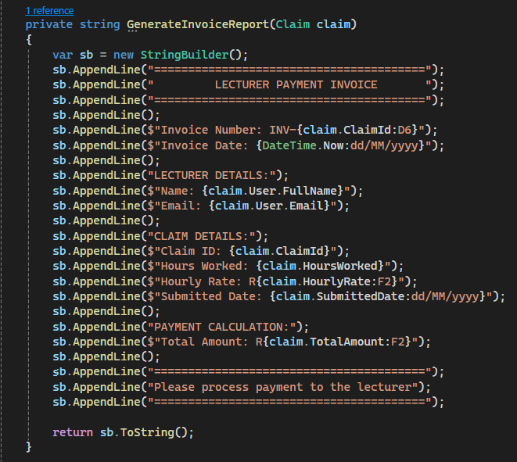
This is the Invoice that is generated for the HR. It is a txt file that is generated and can be downloaded
I used string builder for the code to generate the invoice.

Slide 13
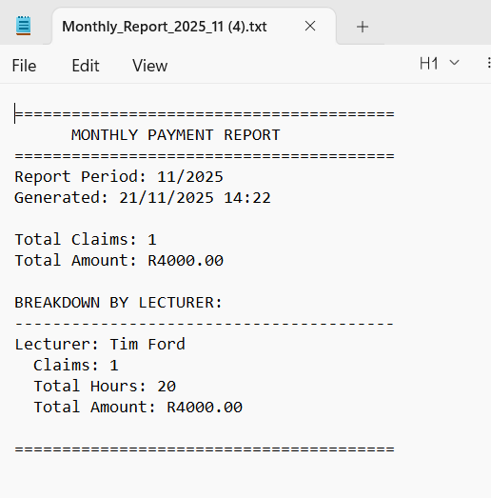
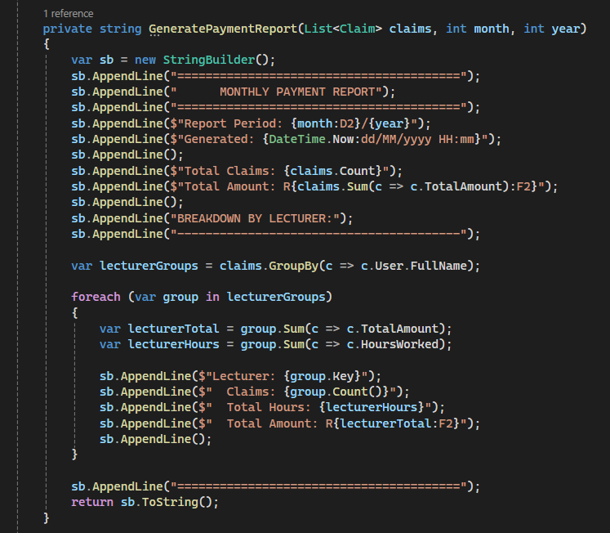
This is the generated Monthly report
I used string builder to form the report.
It gathers all the information of the different claims for the month and gives a summary for the month for each lecturer.

